Slide 1
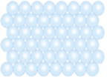

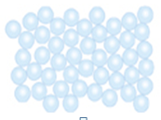
States of Matter
7F Reactions with oxygen – What is burning?
Unit 1
Lesson 1
Solid
Liquid
Gas

Slide 2
Today’s Aim
7F Reactions with oxygen – What is burning?
Unit 1
Lesson 1
By the end of this lesson I will be able to
safely set up and use a Bunsen burner
accurately describe the arrangement, movement and energy of particles in each state of matter

Slide 3
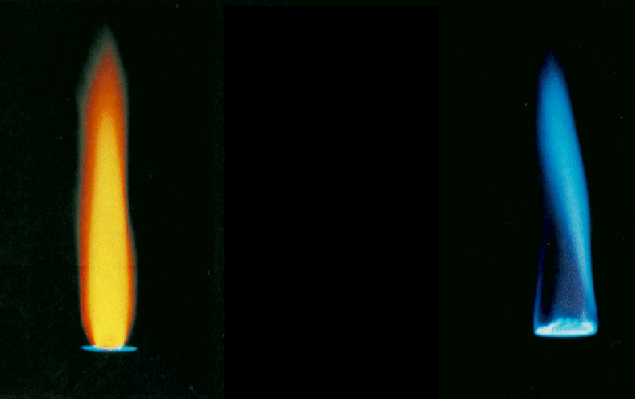


The Bunsen Burner
What is each
flame called?
Safety flame
Roaring flame
air hole closed
air hole open

Slide 4

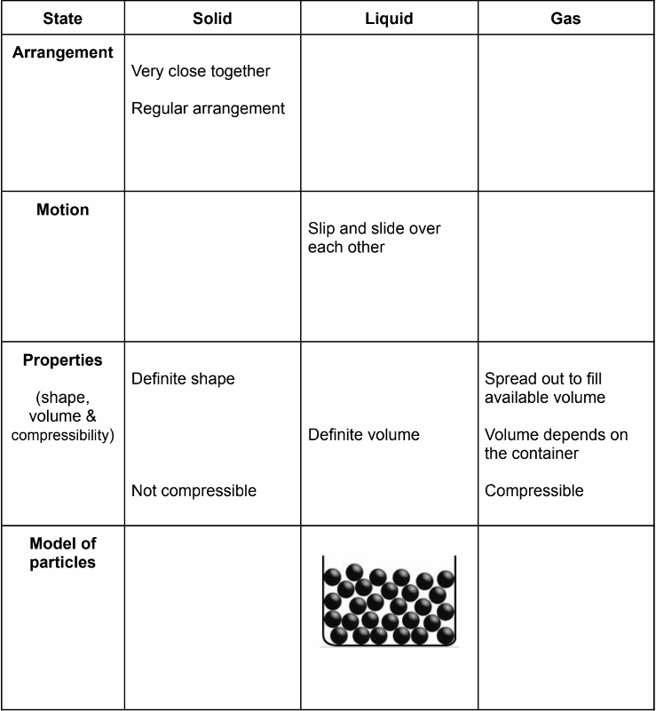

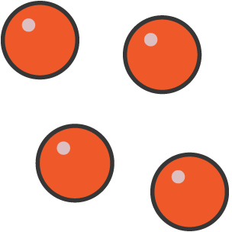

Please complete this table
Class practical
Close together
Far apart
No regular arrangement
No regular arrangement
Fill in the table on page 4 as the substance changes state.
Also answer questions 2, 3 and 4.
Vibrate in a fixed position
Move rapidly in a straight line
Take the shape of the bottom of the container
Definite volume
Not compressible

Slide 5
The Particle Model
According to your exam, there will be two marks for a particle diagram:
Particles in a solid: all touching, pattern
Particles in a liquid: all touching, no pattern
Particles in a gas: no touching, no pattern
You will lose marks for overlapping particles and for different sized particles

Slide 6
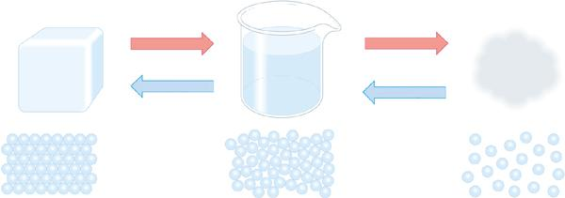
Changes of state
Any substance can be a solid, liquid or a gas. Its state depends on how much energy the particles have.
ice
water
steam
If enough energy is added to or removed from the substance a change of state can occur.

Slide 7
Interconversions of State (page 5)
Solid
freezing
deposition
melting
sublimation
evaporation / boiling
Liquid
Gas
condensing

Slide 8
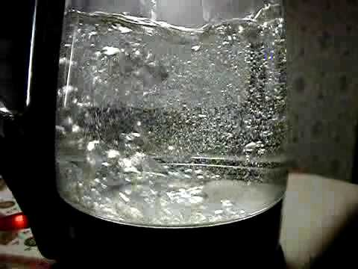

Boiling vs. Evaporation
Boiling is characterised by particles leaving from the body of the liquid so bubbles can be seen throughout. Boiling only occurs at a specific temperature (the boiling point).
Evaporation occurs only at the surface of the liquid and takes place at any temperature below the boiling point.

Slide 9
State Symbols
What is happening here?
H₂O(s) → H₂O(l)
State | Symbol
Solid | (s)
Liquid | (l)
Gas | (g)

Slide 10
Answer question 5 on page 5
a) Water turning into steam
b) Iron (Fe) melting
c) Dry ice turning into carbon dioxide gas
d) Liquifying oxygen from the air
CO₂(s) → CO₂(g)
H₂O(l) → H₂O(g)
Fe(s) → Fe(l)
CO₂(s) → CO₂(g)
O₂(g) → O₂(l)

Slide 11
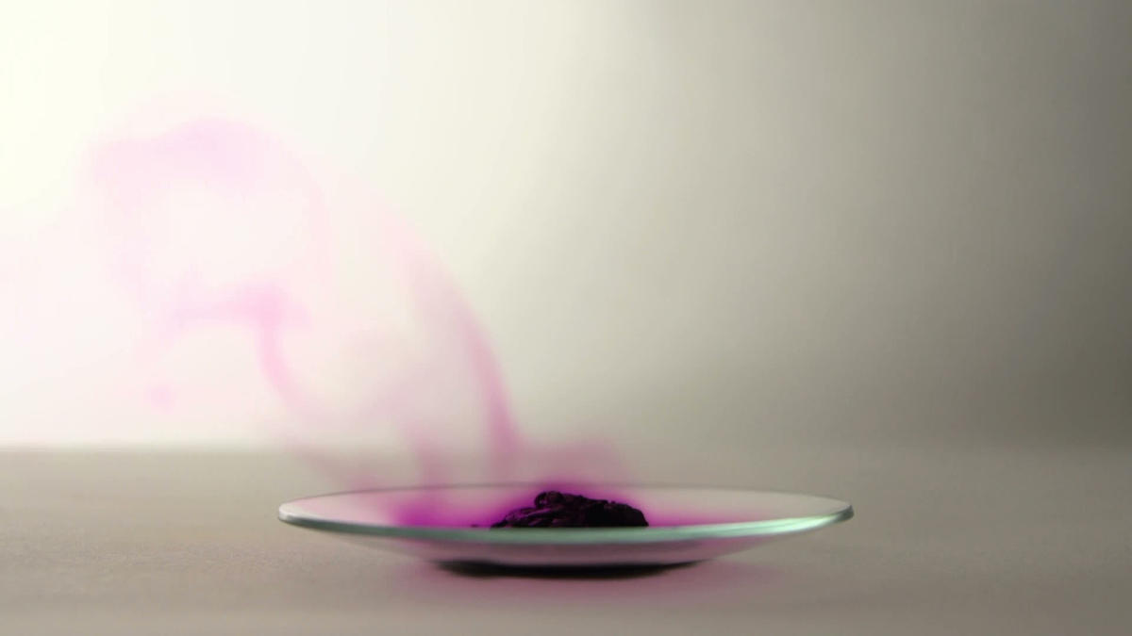
Demo: sublimation
Your teacher may demonstrate the following change of state:
iodine subliming

Slide 12
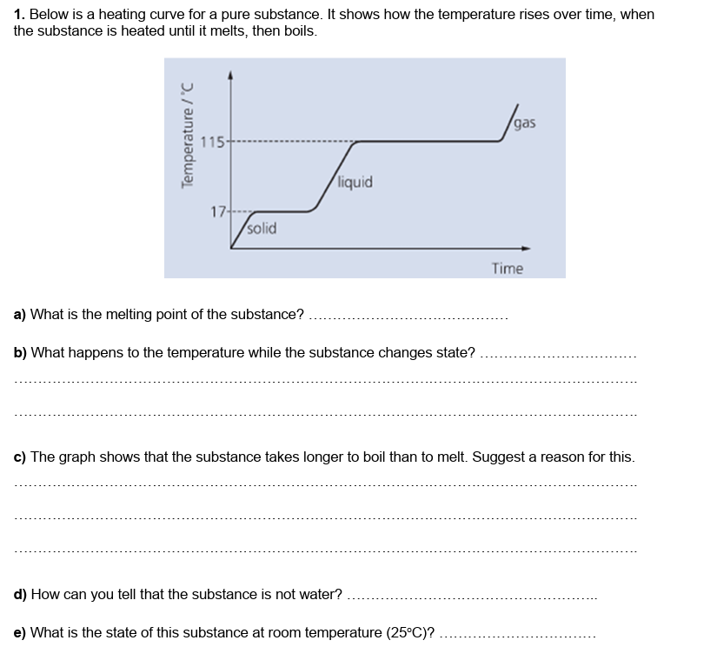
Heating and Cooling Curves (page 6)
17℃
The temperature remains constant
During melting, the forces between the particles are only weakened.
However, during boiling more energy is required as the forces between particles are completely overcome (which takes more energy so takes longer).
does not melt/boil at exactly 0℃ / 100℃
liquid

Slide 13
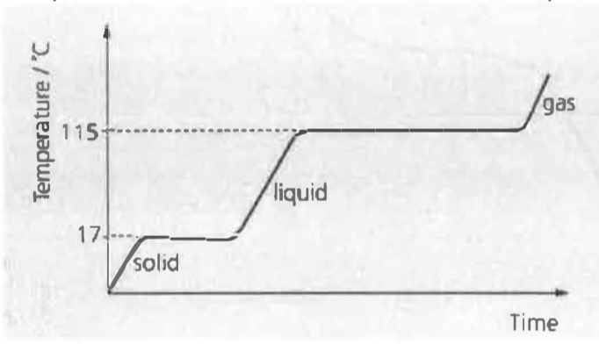
Heating and Cooling Curves (page 6)
heating curve
cooling curve

Slide 14
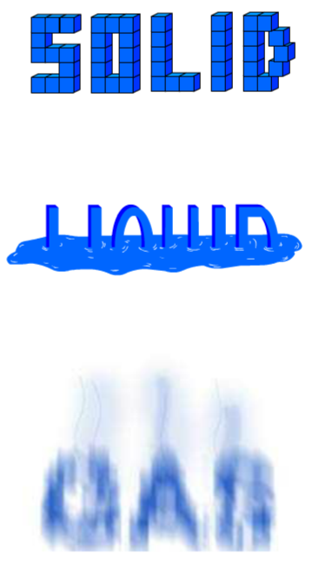
7G The particle model – Solids, liquids and gases
Use these phrases to help answer question g on page 7
the particles in a solid…
- are very close together and arranged in a pattern
- have a small amount of energy
- vibrate in a fixed position
the particles in a liquid…
- are close together but have no fixed arrangement
- have an intermediate amount of energy
- move about and roll over each other
the particles in a gas...
- are far apart and have no fixed arrangement
- have a large amount of energy
- move rapidly in all directions

Slide 15
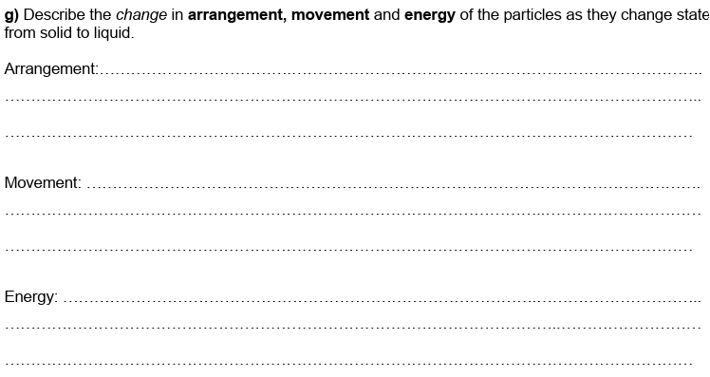
Describing changes of state
Changes from a regular arrangement to no pattern
Changes from particles only vibrating in a fixed position to rolling about over each other.
The energy of the particles increases

Slide 16
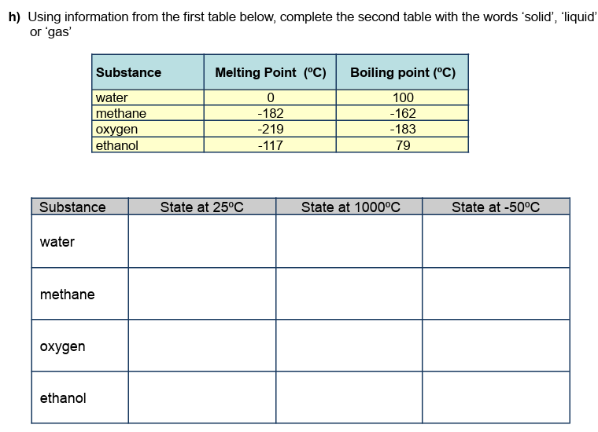
Using Melting and Boiling Points
Substance | Melting Point (ºC) | Boiling point (ºC)
water | 0 | 100
methane | -182 | -162
oxygen | -219 | -183
ethanol | -117 | 79
liquid
gas
solid
gas
gas
gas
gas
gas
gas
liquid
gas
liquid

Slide 17
8I The truth about particles
Plenary: true or false?
Particles in solids are much closer together than the particles in gases.
Particles in liquids cannot move around at all.
Sublimation is when a solid turns into a gas without a liquid phase.
The volume of a liquid cannot change but it’s shape can change.
TRUE
FALSE
TRUE
TRUE

Slide 18
8I The truth about particles
Plenary: true or false?
The particles are far apart in gases which means they tend to be more dense than liquids and solids.
When a solid melts the distance between the particles increases.
This equation: NaCl(l) → NaCl(s) shows sodium chloride salt melting
Gases can be compressed because there is so much empty space between the particles.
FALSE
TRUE
FALSE
TRUE

Slide 19
What you need to know
Unit 1
Lesson 1
Syllabus Content
1.1 understand the three states of matter in terms of the arrangement, movement and energy of the particles.
1.2 understand the interconversions between the three states of matter in terms of:
• the names of the interconversions
• how they are achieved
• the changes in arrangement, movement and energy of the particles.
My Learning

